Slide 1
Project plan for Skroman ERP
Screens related to Skroman ERP

Slide 2
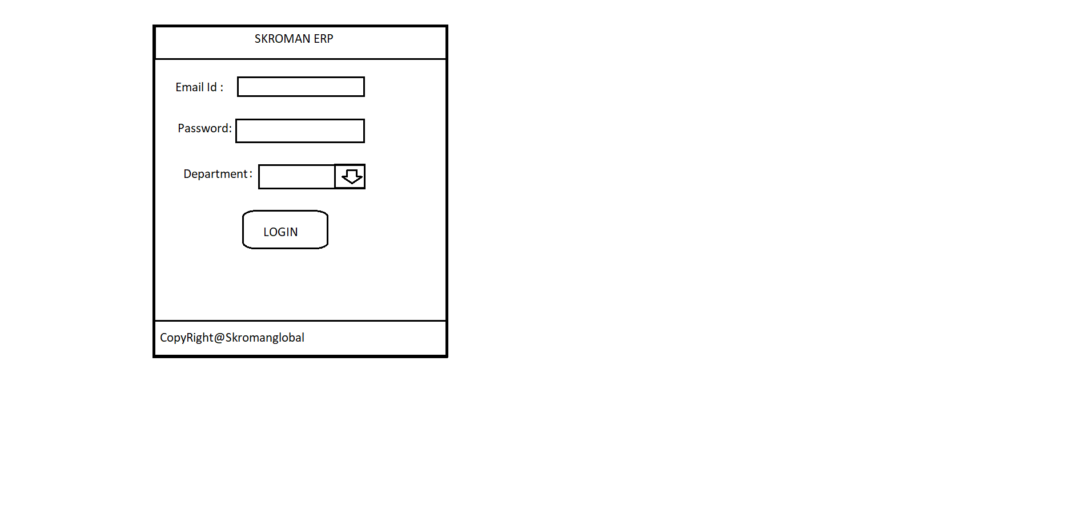
Screen1: Login page

Slide 3
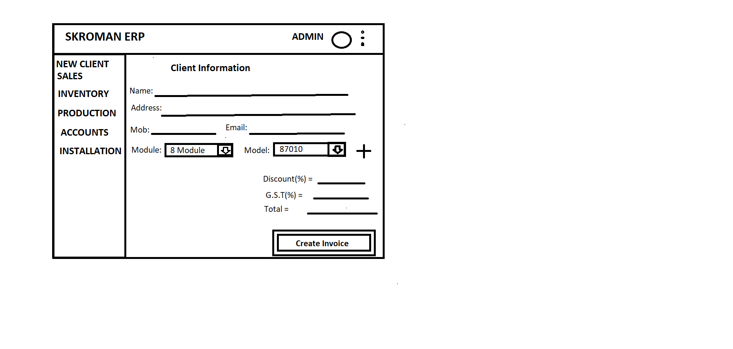
Screen 2: Admin

Slide 4
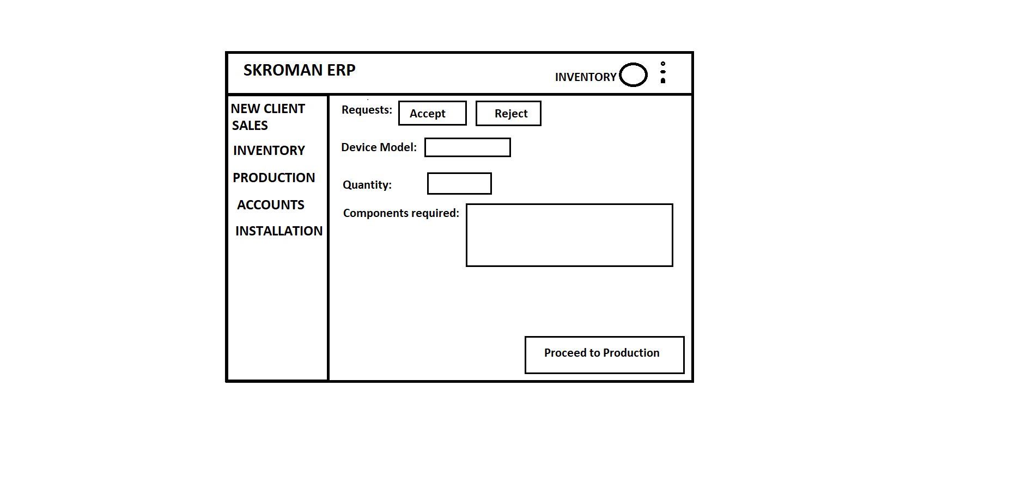
Screen 3 :Inventory

Slide 5
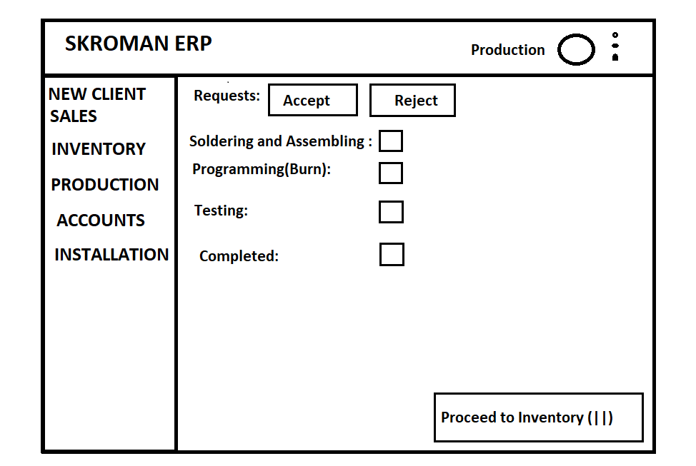
Screen 4 : Production

Slide 6
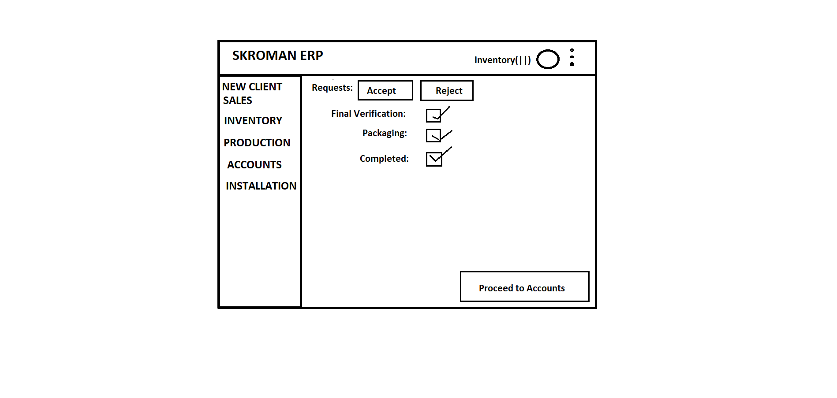
Screen 5: Inventory(||)

Slide 7
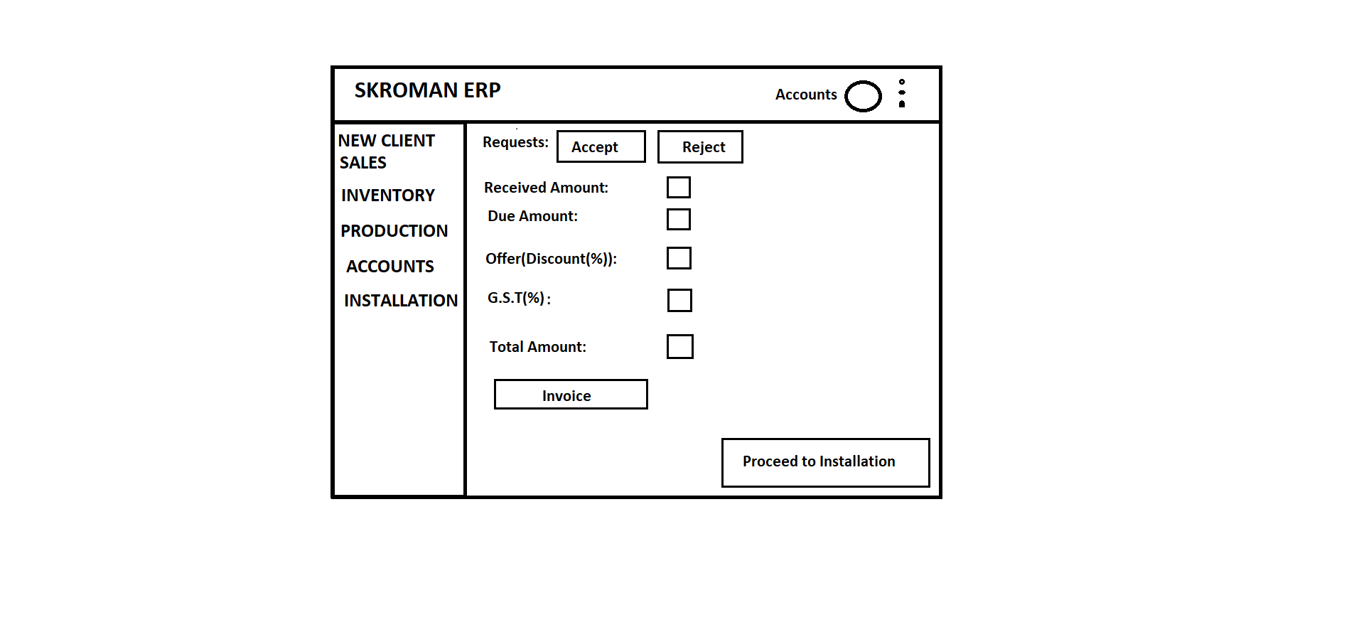
Screen 6: Accounts

Slide 8
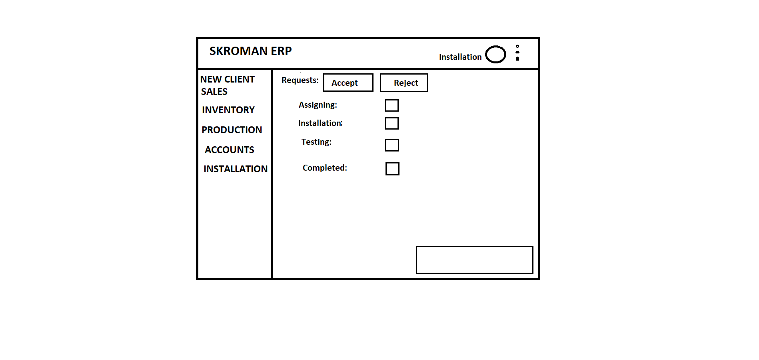
Screen 7: Installation

Slide 9
Thank you

